Slide 1
Project 4 OCR Error Detection and Error Correction
Group 7

Slide 2
Preparation
Error Detection: D-2
Positional Binary n-gram
Error Correction: C-5
Topic Modeling

Slide 3
Error Detection:
Word Dictionary: A list generated from “Ground Truth” folder with all words in 100 papers
Each entry in the dictionary is a vector of all the words with the same length
Positional Binary-n grams Dictionary:
For each level-k in the dictionary, generate C(k,2) list, each list gives all possible pairs of letters of every possible position pairs
Example is on next page

Slide 4
Example Positional Binary n-gram:
(1,2) | ni
(1,3) | nk
(1,4) | ne
(2,3) | ik
(2,4) | ie
(2,5) | ke
nike
n
i
k
e
K = 4, in the n-gram
C(4,2) = 6, # of lists in the K=4 entry

Slide 5
Error Detection
For each word in the Tesseract papers:
Remove punctuation, numbers and special characters
Transform to lower case
List its Positional Binary-n grams
Compare with Positional Binary-n Grams dictionary, if there is one pair doesn’t appear in the dictionary, the word is WRONG

Slide 6
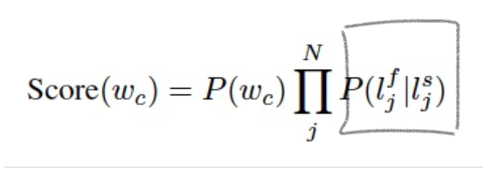
Error Correction: Confusion Matrix
Confusion Matrix: (1988 AP Corpus)
Dim: 26X26, represents letter a – z respectively
Entry: frequency of each letter was mistaken for another letter

Slide 7
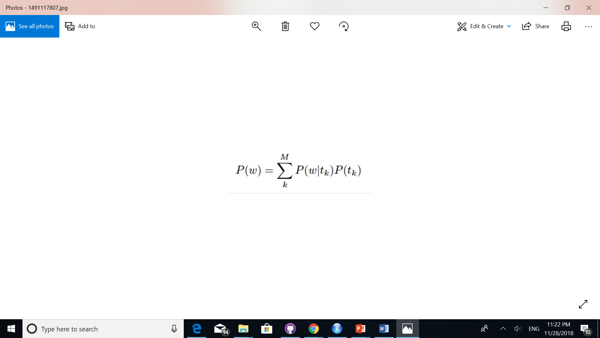
Error Correction: LDA Per-word-per-topic Probability Remove punctuation, stop-words, spaces, transform to lower letter form Output a list of word’s probabilities among 100 ground truth, with probability represents below.

Slide 8
Error Correction: Candidate List
Write function to find all words in the “Word Dictionary” of the same length as the wrong word and has no more than 2 letters different from the wrong words.
Compare the word list after step 1 to the result of LDA model:
If the a word in the step 1 is in the LDA result, the word will be considered as a candidate, otherwise not.

Slide 9
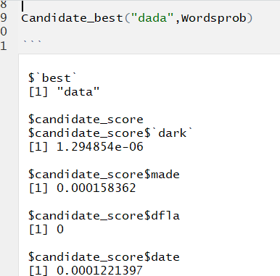
Correction: Example
For each word in candidate:
Calculate the Score(w) according to the Confusion Matrix and LDA result
Choose the word with highest Score(w) to replace

Slide 10
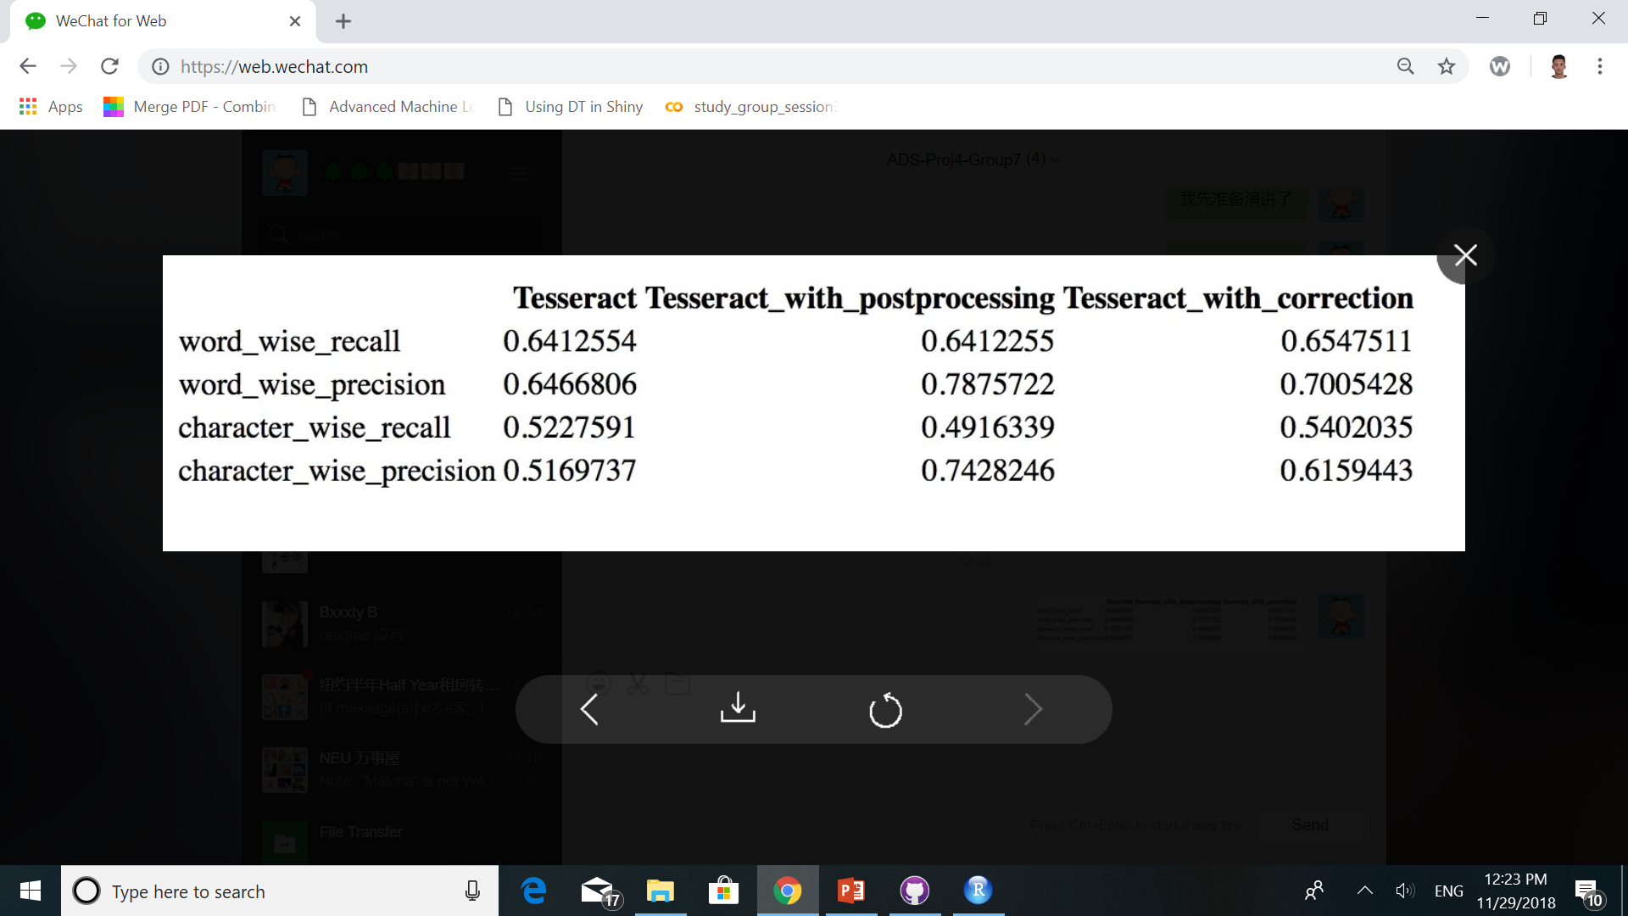
Performance After Correction

Slide 11
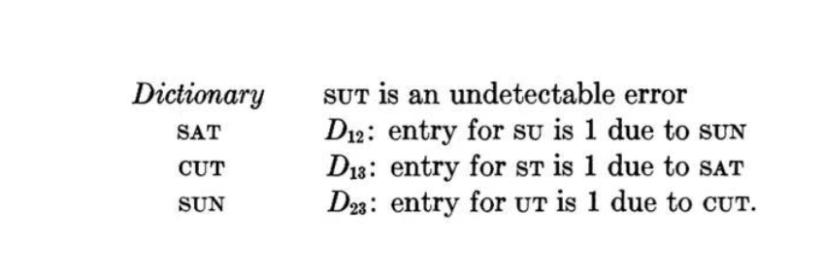
Issues: Undetectable Error

Slide 12
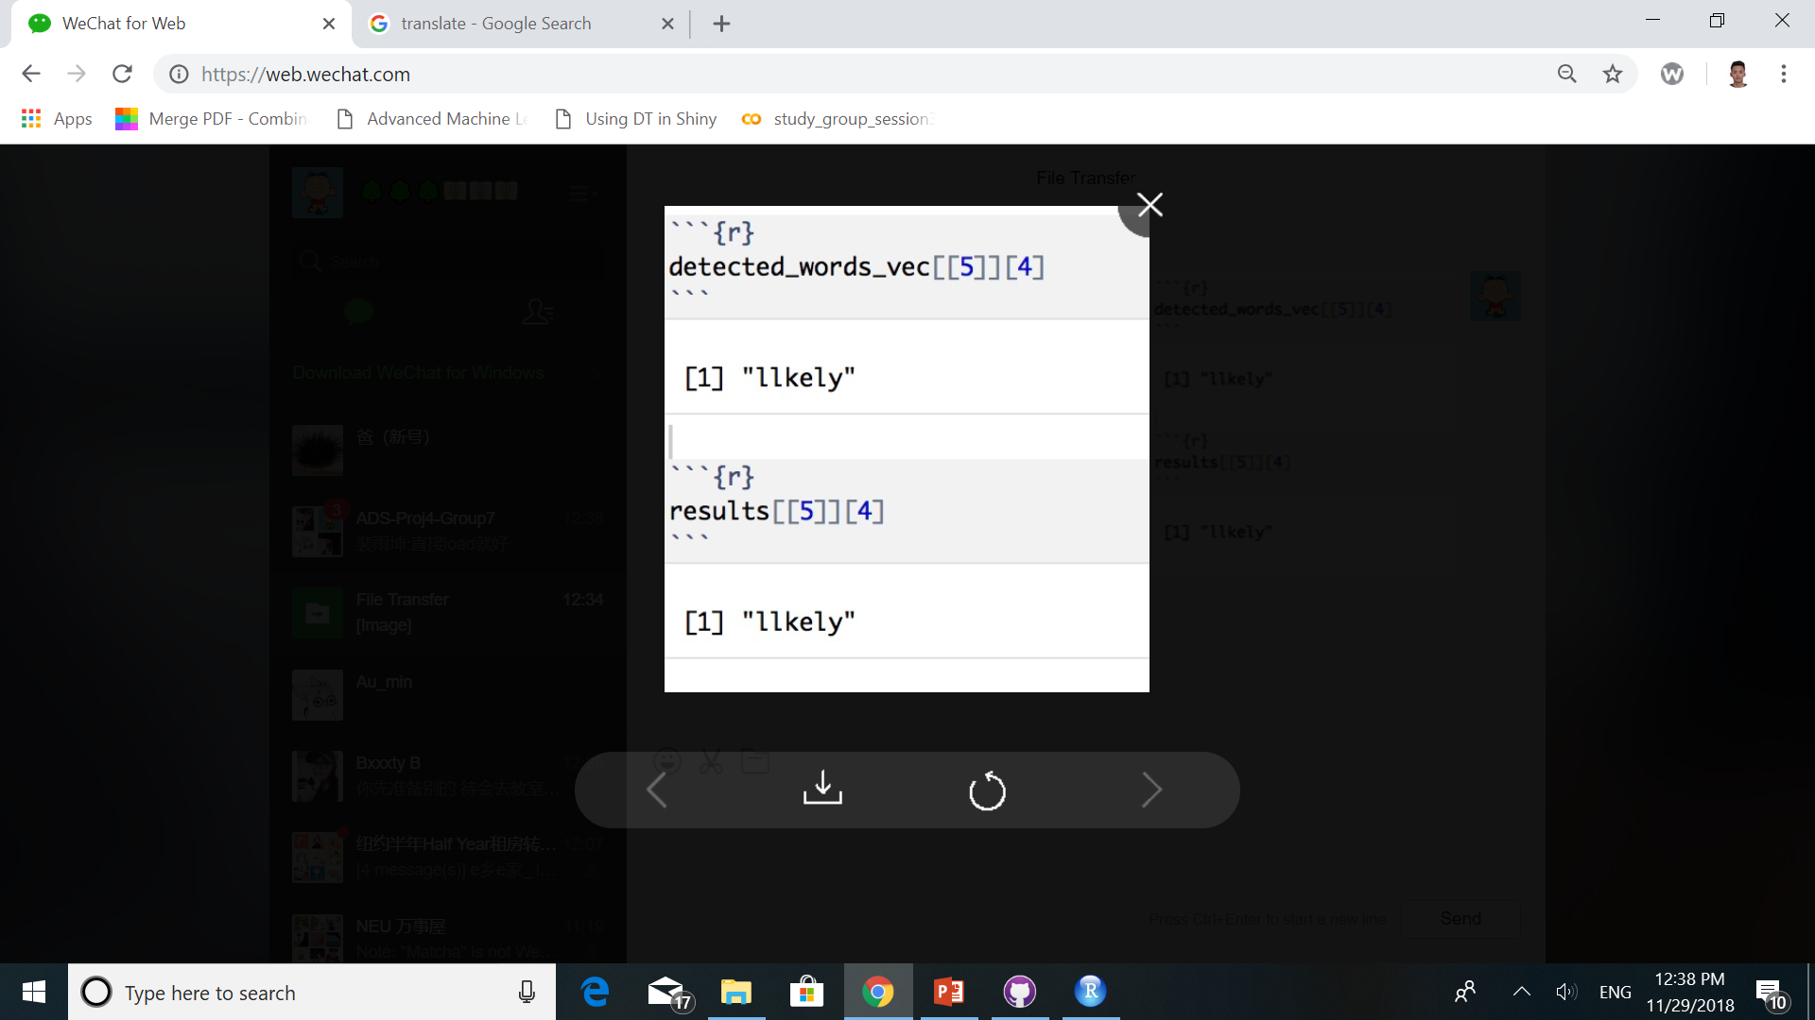
Issues: Temporal of the words not in LDA result

Slide 13

Issues: Stop-words not in LDA result

Slide 14
Questions
Thank you for listening !

